Slide 1
Survey about Migration, Refugees and EU-Citizenship!
Tuesday, June 25, 2019

Slide 2
122
Total Responses
Date Created: Friday, December 08, 2017
Complete Responses: 122

Slide 3
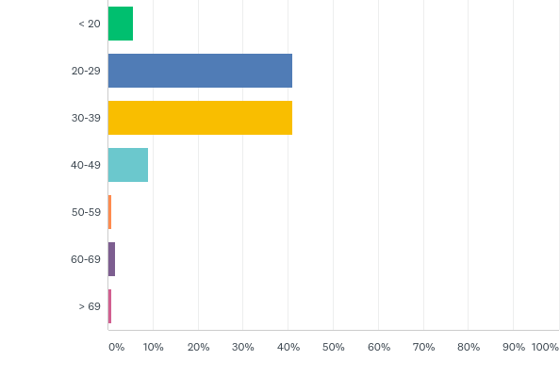
Age was predominantly young with a very low participation of the older generation
Answered: 122 Skipped: 0

Slide 4
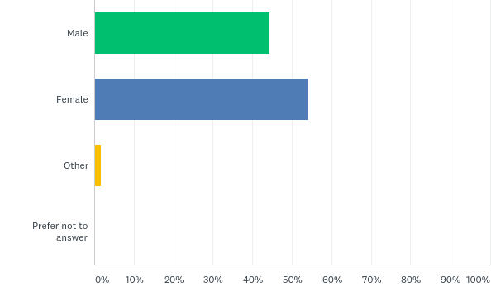
In terms of Gender we achieved almost perfect balance
Answered: 122 Skipped: 0

Slide 5
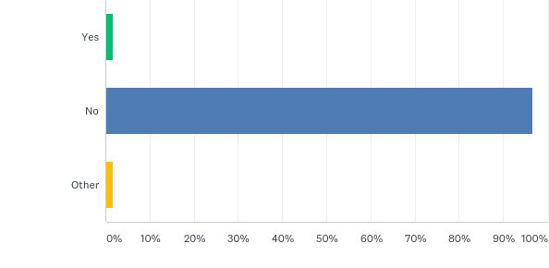
Most people were not migrants or refugees
Answered: 122 Skipped: 0

Slide 6
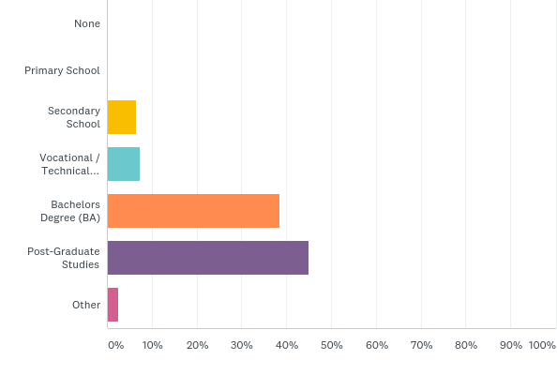
And most responders held advanced degrees, as is the EU average
Answered: 122 Skipped: 0

Slide 7
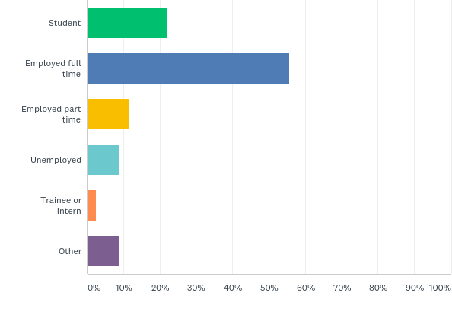
Occupations was also equally representative
Answered: 122 Skipped: 0

Slide 8
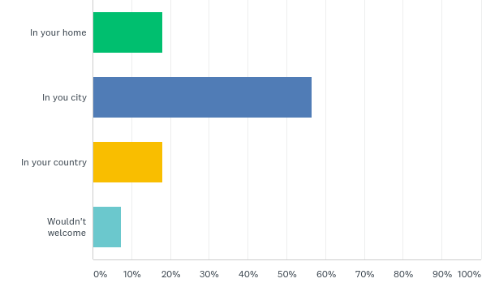
In the questions whether they would welcome a refugee most people selected their cities
Answered: 122 Skipped: 0

Slide 9
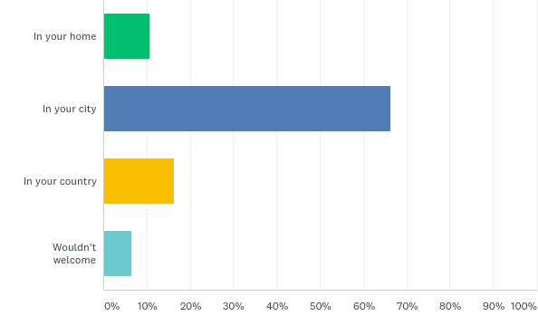
In the questions whether they would welcome a migrant, most people selected their cities
Answered: 122 Skipped: 0

Slide 10
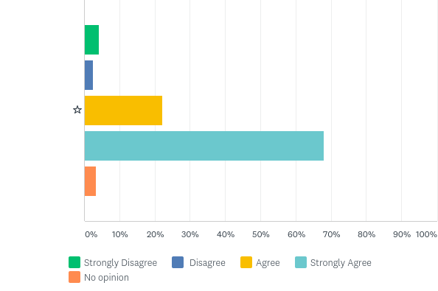
On the statement “Our Government should help refugees that run away from war and persecution“ most people seem to be strongly in favour
Answered: 122 Skipped: 0

Slide 11
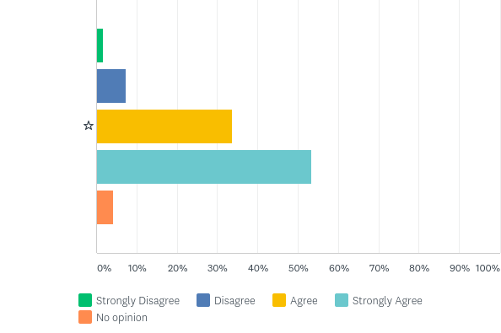
On the statement “Refugees should have the same rights as nationals in terms of housing, education and health“most people seem to be strongly in favour
Answered: 122 Skipped: 0

Slide 12
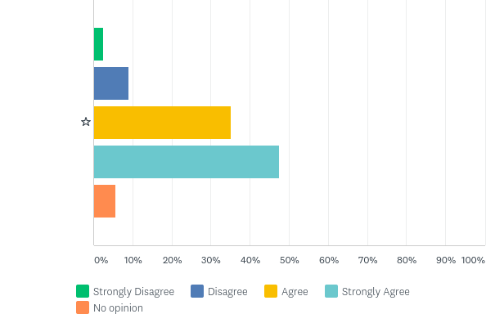
On the statement “Immigrants should have the same rights as nationals in terms of housing, education and health“, people were a little more divided
Answered: 122 Skipped: 0

Slide 13
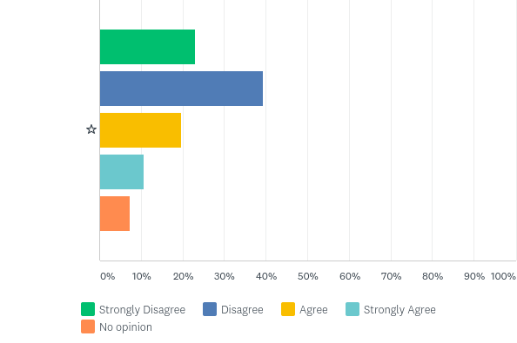
On the statement that Migrants should not be granted the host country’s nationality most people disagreed, as they seem to be more multicultural inclined
Answered: 122 Skipped: 0

Slide 14
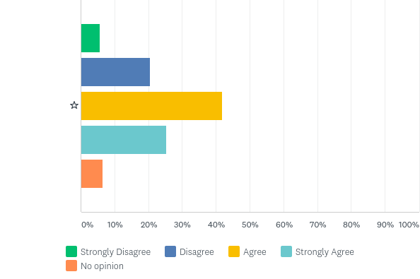
Most people also agree that the European Union should decide on the conditions for legal entry and residence in all EU countries and this should not be handled by individual countries
Answered: 122 Skipped: 0

Slide 15
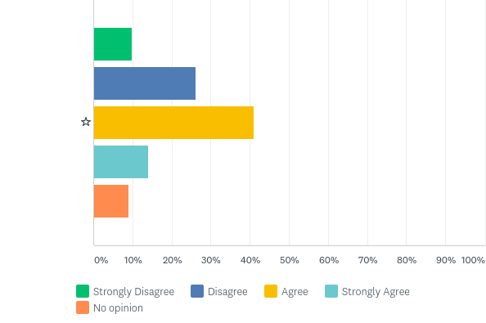
Furthering the point, people believe that the European Union should define on the admission volumes for people coming from non-EU countries to seek work
Answered: 122 Skipped: 0

Slide 16
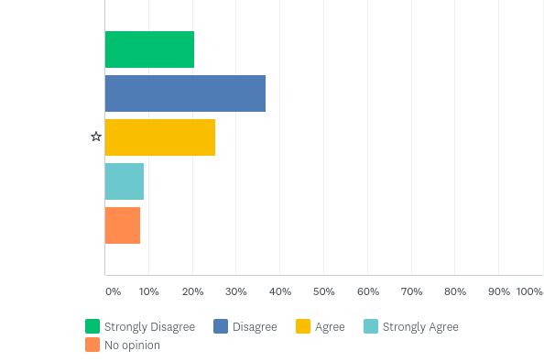
Again hammering the point that the EU with its human rights minded perspective should decide on the conditions of entry, residence and deportation of migrants
Answered: 122 Skipped: 0

Slide 17
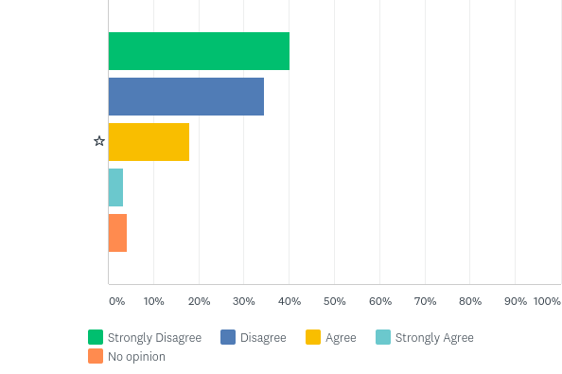
Going on the opinion section, participants were asked to rate the statement that refugees are a burden to the economy, and the argument, however small becomes more confused
Answered: 122 Skipped: 0

Slide 18
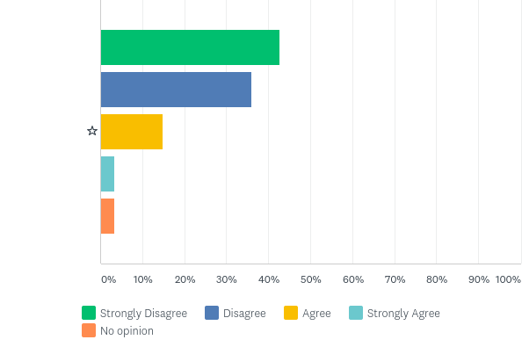
The same statement is less true for immigrants
Answered: 122 Skipped: 0

Slide 19
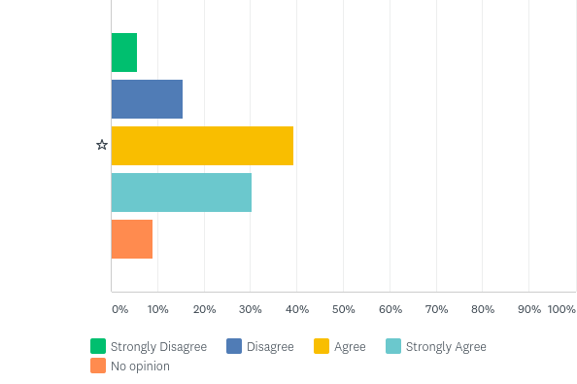
Most responders believe that refugees are an added value to the economy
Answered: 122 Skipped: 0

Slide 20
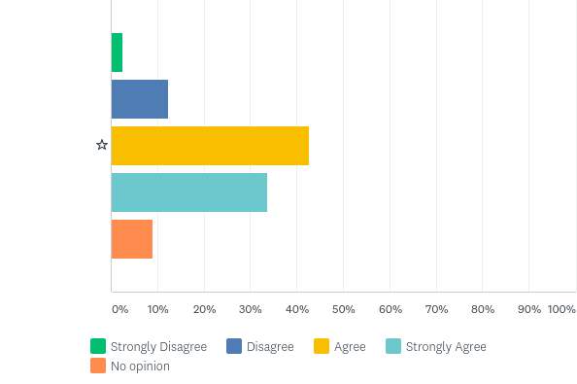
Which holds the same value as the statement that, “Immigrants are an added value to the economy"
Answered: 122 Skipped: 0

Slide 21
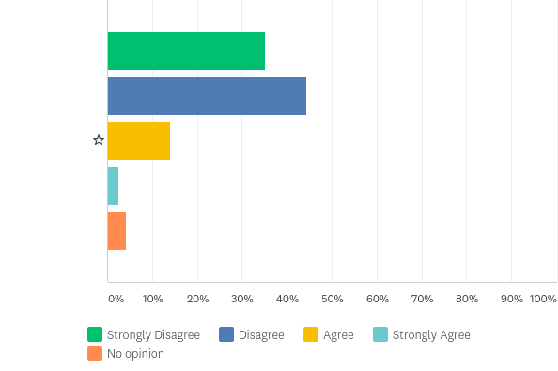
Most participants also believe that the increase of migrants will decrease the job offers to the host country nationals
Answered: 122 Skipped: 0

Slide 22
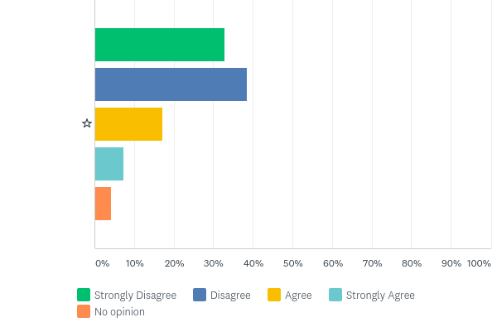
Participants were also liberal about the job skills that migrants bring in the economy, trusting that the entrepreneurial spirit will carry them through
Answered: 122 Skipped: 0

Slide 23
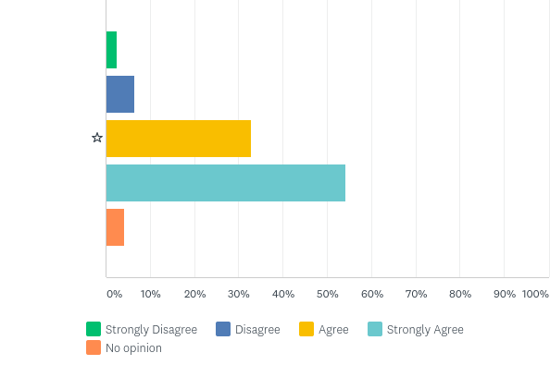
Most countries believe that cultural diversity is important for their country
Answered: 122 Skipped: 0

Slide 24
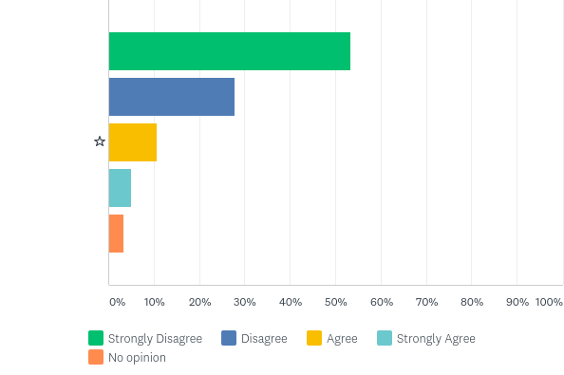
Most participants also don’t feel that the increase of the number of refugees causes an increase of terrorism acts in Europe
Answered: 122 Skipped: 0

Slide 25
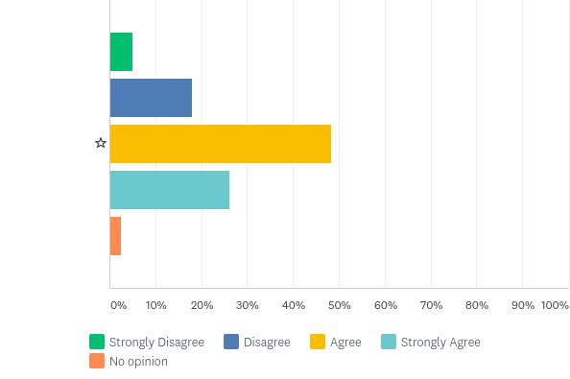
Most participants to the survey believe in a intercultural world rather than a multicultural one, as they believe that migrants must integrate the culture of the host country
Answered: 122 Skipped: 0

Slide 26
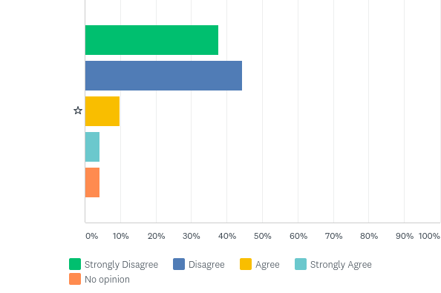
Most people also believe that the entry of migrants harms the cultural identity of the host country
Answered: 122 Skipped: 0

Slide 27
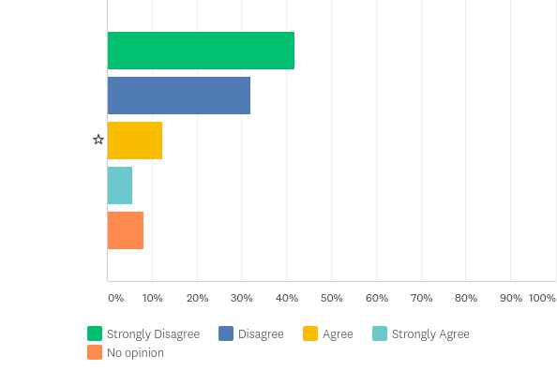
Q28: Social and Cultural Dimension. Media tend to give a positive news about migration issues
Answered: 122 Skipped: 0

Slide 28
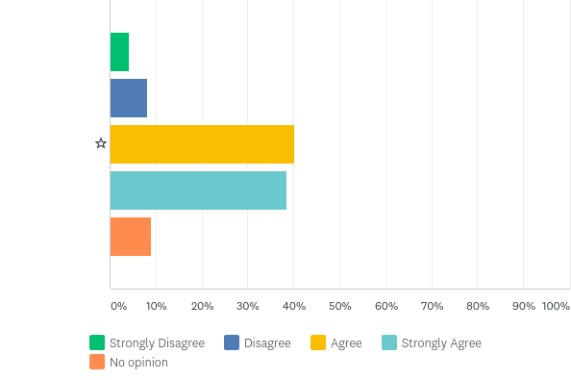
And the are aware that media tend to reinforce the stereotypes related to migrants
Answered: 122 Skipped: 0

Slide 29
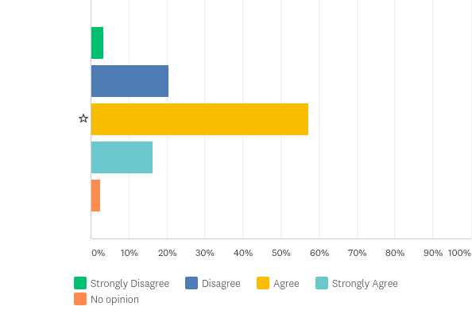
In the effort for an intercultural society most participants believe migrants should speak the official language of the host country
Answered: 122 Skipped: 0

Slide 30
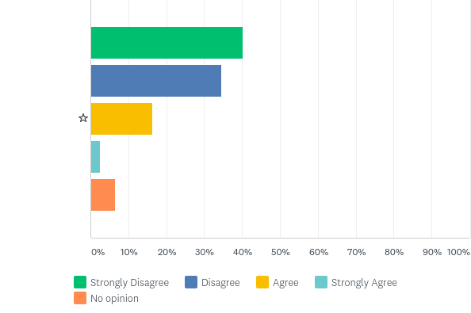
Most participants also don’t feel that the increase of the number of migranrts causes an increase of crimes and insecurity in Europe
Answered: 122 Skipped: 0

Slide 31
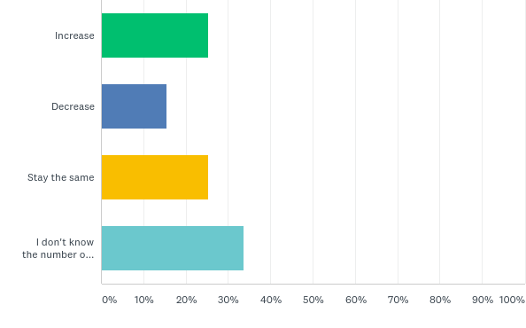
Most people seem to not have a clear view on the benefits of migrations when asked if the number of immigrants should…
Answered: 122 Skipped: 0

Slide 32
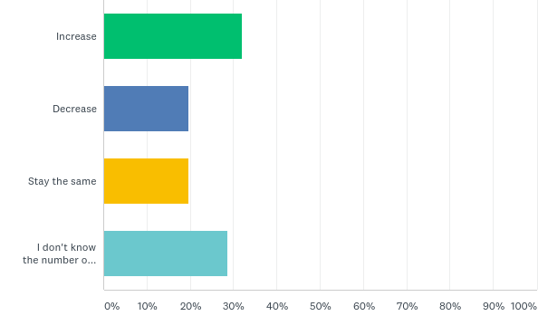
Most people seem to not have a clear view on the benefits of migrations when asked if the number of refugees should…
Answered: 122 Skipped: 0

Slide 33
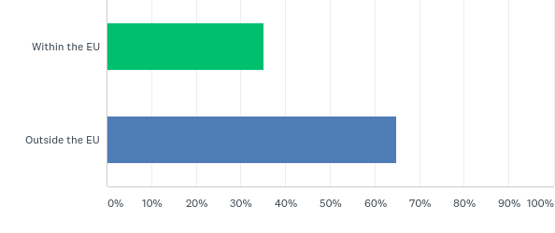
Most participants tot the survey worry more about citizens moving from outside EU countries instead of intra-European migrants, even though these flows are much more substantial
Answered: 122 Skipped: 0

Slide 34
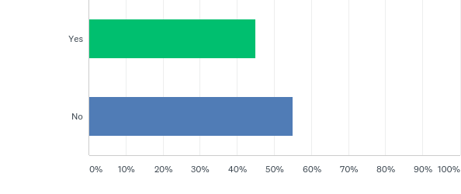
The response was split in the question whether Europe should encourage more migrants to enter the country or not, with a strong favour to not.
Answered: 122 Skipped: 0

Slide 35
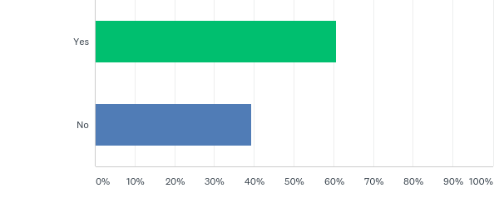
Most participants had close personal relations with migrants or refugees?
Answered: 122 Skipped: 0

Slide 36
By far the more interesting question was to imagine in which country of Europe would they choose to live in if they were a migrant
Answered: 122 Skipped: 0
Most participants responded either none, or chose economically strong countries like, France, Germany, Italy, UK or countries with strong state safety nets like Austria, Finland, Portugal, Spain and Sweden

Slide 37
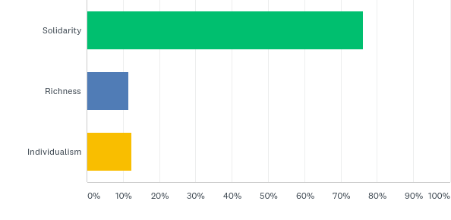
Most people now that the generic European Value is…
Answered: 122 Skipped: 0

Slide 38
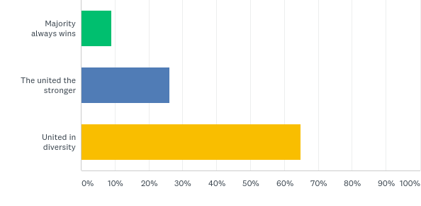
The majority of the participant’s know that the motto of the EU is
Answered: 122 Skipped: 0

Slide 39
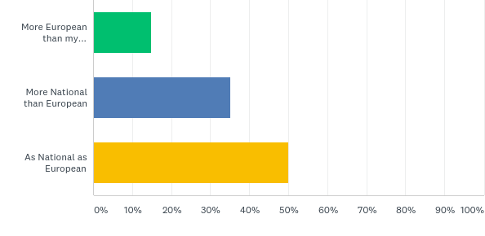
Most people feel their National identity more clearly than their EU identity
Answered: 122 Skipped: 0

Slide 40
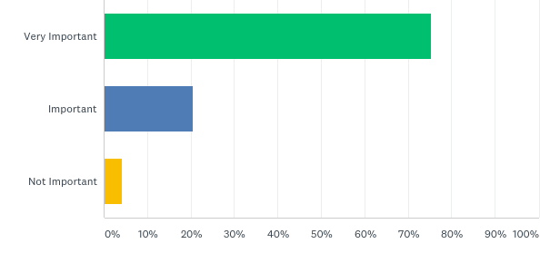
Most people think it is important to work on the awareness raising of migration issues
Answered: 122 Skipped: 0

Slide 41
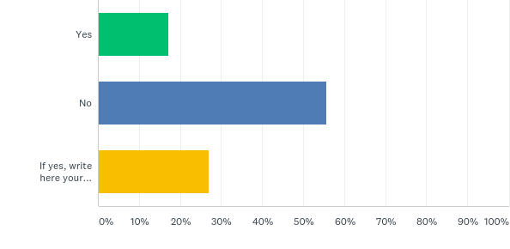
Finally, while a number of people provided their email to keep up with the activities of the project a number of these progressive participants are probably saturated with information about these subjects.
Answered: 122 Skipped: 0

